Slide 1


Saji Vallachira
03/01/2025

Slide 2

Outline
Executive Summary
Introduction
Methodology
Results
Conclusion
Appendix

Slide 3
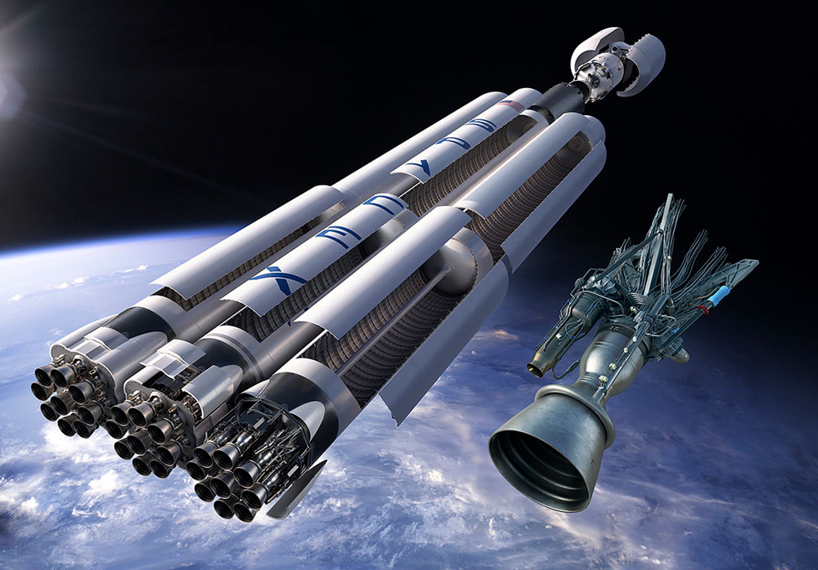
Executive Summary
SpaceY, a competitor of SpaceX, employs data from SpaceX's Falcon 9 rocket to analyze first stage landing successes and launch costs. This report provides a comprehensive summary of the methodologies and results.
Summary of methodologies
Data Collection
Data wrangling
Exploratory data analysis with data visualization and SQL
Building an interactive map with Folium
Building Dashboard with Plotly Dash
Predictive analysis (classification)
Summary of all results
• Exploratory data analysis results
• Interactive analytics demo in screenshots
• Predictive analysis results

Slide 4
Introduction
Project background and context
SpaceX is the most successful company of the commercial space age, making space travel affordable. The company advertises Falcon 9 rocket launches on its website, with a cost of 62 million dollars; other providers cost upward of 165 million dollars each, much of the savings is because SpaceX can reuse the first stage. Therefore, if we can determine if the first stage will land, we can determine the cost of a launch. Based on public information and machine learning models, we are going to predict if SpaceX will reuse the first stage.
Questions to be answered
- How do variables such as payload mass, launch site, number of flights, and orbits affect the success of the first stage landing?
- Does the rate of successful landings increase over the years?
- What is the best algorithm that can be used for binary classification in this case?

Slide 5

Section 1

Slide 6
Methodology
Data collection methodology:
Using SpaceX Rest API
Using Web Scrapping from Wikipedia
Perform data wrangling
Filtering the data
Dealing with missing values
Using One Hot Encoding to prepare the data to a binary classification
Perform exploratory data analysis (EDA) using visualization and SQL
Using libraries such as seaborn and matplotlib for visualization and SQL for data quires.
Perform interactive visual analytics using Folium and Plotly Dash
Using the following libraries Folium and Plotly Dash
Perform predictive analysis using classification models
Building, tuning and evaluation of classification models to ensure the best results

Slide 7
Data Collection
Data was collected from two main sources
SpaceX API: Open Source REST API for launch, rocket, core, capsule, starlink, launchpad, and landing pad data.
Wikipedia: is a free online encyclopedia, created and edited by volunteers around the world and hosted by the Wikimedia Foundation
Process of Data Collection
SpaceX API
JSON Format
Jupyter Notebook
on IBM Watson
Pandas
Data Frame
Wikipedia
Web Scrapping
TXT Format

Slide 8
Data Collection – SpaceX API
We initiated data collection from the SpaceX API by importing essential libraries, including pandas, NumPy, and Requests. Subsequently, we established a URL GET request, which returned a JSON file. This file was then converted into a data frame by selecting the requisite information, such as geospatial data, rocket type, orbit, flight number, and additional parameters.
Data Collection Process from
SpaceX API
Jupyter Notebook
on IBM Watson
SpaceX API
GET Request
JSON Response
Data Frame
Github URL: https://github.com/sajivallachira/Capstone/blob/main/1.%20spacex-data-collection-api.ipynb

Slide 9
Data Collection - Scraping
As previously, we began by importing the necessary Python libraries, Beautiful Soup and Requests, to perform our task. This time, we utilized a Wikipedia webpage titled 'SpaceX Falcon 9 First Stage Landing Prediction' as our data source. We then initialized an HTTP GET request, with the response returned in text format. Using the Beautiful Soup library, we effectively extracted the tables and columns from the text response, subsequently converting them into a Pandas DataFrame.
Data Collection via Wikipedia webpage
scrapping
Jupyter Notebook
on IBM Watson
Wikipedia
webpage
GET Request
TEXT Response
Beautiful Soup
Data Frame
Github URL: https://github.com/sajivallachira/Capstone/blob/main/2.%20webscraping.ipynb

Slide 10
Data Wrangling
In this stage, we began by importing the necessary Python libraries, pandas and NumPy. We then loaded the data collected in the previous stage to conduct exploratory data analysis, with the objective of cleaning the data and selecting valid features for training a machine learning model.
1- Loading the collected dataset.
2- Identifying and calculating the % of the missing values in each attribute
3- Identifying which columns are numerical and categorical
6- Creating a landing outcome label from
Outcome column
5- Calculating the number and occurrence
of each orbit
4- Calculating the number of launches on
each site
7- determining the success rate of
returning the first stage of the rocket
Github URL: https://github.com/sajivallachira/Capstone/blob/main/3.%20spacex-Data%20wrangling.ipynb

Slide 11
EDA with Data Visualization
Charts plotted:
Flight Number vs. Payload Mass
Flight Number vs. Launch Site
Payload Mass
vs. Launch Site
Orbit Type vs. Success Rate
Flight Number vs. Orbit Type
Payload Mass vs Orbit Type
Success Rate Yearly Trend
Scatter plots show the relationship between variables. If a relationship exists,
they could be used in machine learning model.
Bar charts show comparisons among discrete categories. The goal is to show the
relationship between the specific categories being compared and a measured
value.
Line charts show trends in data over time (time series).
Github URL: https://github.com/sajivallachira/Capstone/blob/main/4.%20EDA%20with%20Data%20Visualization.ipynb

Slide 12
EDA with SQL
In this stage we used SQL queries as shown on the right to complete our EDA on our collected dataset
Displaying the names of the unique launch sites in the space mission
Displaying 5 records where launch sites begin with the string ‘CCA'
Displaying the total payload mass carried by boosters launched by NASA (CRS)
Displaying average payload mass carried by booster version F9 v1.1
Listing the date when the first successful landing outcome in ground pad was achieved
Listing the names of the boosters which have success in drone ship and have payload mass greater than 4000 but less than 6000
Listing the total number of successful and failure mission outcomes
Listing the names of the booster versions which have carried the maximum payload mass
Listing the failed landing outcomes in drone ship, their booster versions and launch site names for the months in year 2015
Ranking the count of landing outcomes (such as Failure (drone ship) or Success (ground pad)) between the date 2010-06-04 and 2017-03-20 in descending order
Github URL: https://github.com/sajivallachira/Capstone/blob/main/5.%20eda-sql-coursera_sqllite.ipynb

Slide 13
Build an Interactive Map with Folium
In this stage we used folium library to represent our work as geospatial data by drawing markers circles and lines on an interactive map.
Markers of all Launch Sites:
- Added Marker with Circle, Popup Label and Text Label of NASA Johnson Space Center using its latitude and longitude coordinates as a start location.
Added Markers with Circle, Popup Label and Text Label of all Launch Sites using their latitude and longitude coordinates to show their geographical locations and proximity to Equator and coasts.
Coloured Markers of the launch outcomes for each Launch Site:
Added coloured Markers of success (Green) and failed (Red) launches using Marker Cluster to identify which launch sites have relatively high success rates.
Distances between a Launch Site to its proximities:
- Added coloured Lines to show distances between the Launch Site KSC LC-39A (as an example) and its proximities like Railway, Highway, Coastline and Closest City.
Github URL: https://github.com/sajivallachira/Capstone/blob/main/6.%20Interactive%20Visual%20Analytics%20with%20Folium.ipynb

Slide 14
Build a Dashboard with Plotly Dash
Launch Sites Dropdown List:
Added a dropdown list to enable Launch Site selection.
Pie Chart showing Success Launches (All Sites/Certain Site):
Added a pie chart to show the total successful launches count for all sites and the Success vs. Failed counts for the site, if a specific Launch Site was selected.
Slider of Payload Mass Range:
Added a slider to select Payload range.
Scatter Chart of Payload Mass vs. Success Rate for the diﬀerent Booster Versions:
- Added a scatter chart to show the correlation between Payload and Launch Success.
Github URL: https://github.com/sajivallachira/Capstone/blob/main/7.%20spacex_dash_app.py

Slide 15
Predictive Analysis (Classification)
Machine Learning Stages:
1. Importing The
Required
Libraries
2. Loading the
cleaned data.
Importing the required libraries.
Loading the cleaned data.
Standardizing the data to prevent the bias.
splitting the data into 20% for testing data and 80% training data.
Initializing 4 different classification algorithms:
Logistic Regression (LR)
Support Vector Machine (SVM)
Decision Tree (DT)
K nearest neighbors (KNN)
Using Grid Search technique to find the best parameters
Using Evaluation techniques including, Confusion matrix, F1 score, Jaccard Score for the purpose of using the best model among the algorithms above.
4. Splitting the
data into
Test/Train sets
3.Standardizing
the data
5. Initializing
classification
algorithms
6. Using Grid
Search
technique
8. Identifying the best model and parameters
7. Using
Evaluation
techniques
Github URL: https://github.com/sajivallachira/Capstone/blob/main/8.%20Machine%20Learning%20Prediction.ipynb

Slide 16
Results
Exploratory data analysis results
Interactive analytics demo in screenshots
Predictive analysis results

Slide 17

Section 2

Slide 18
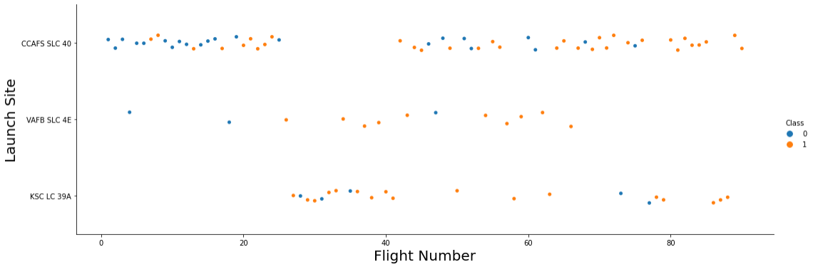
Flight Number vs. Launch Site
The majority of the flights were launched from the CCAFS SLC 40 sites.
The VAFB SLC 4E and KSC LC 39A sites have higher success rates than other sites.
Newer flights have higher success rates than older flights.

Slide 19
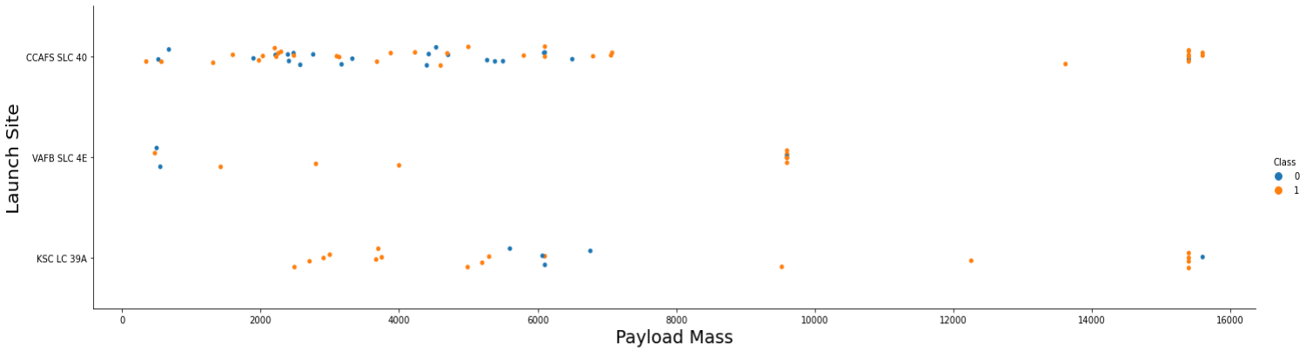
Payload vs. Launch Site
For every launch site the higher the payload mass, the higher the success rate.
Most of the launches with payload mass over 7000 kg were successful.
KSC LC 39A has a 100% success rate for payload mass under 5500 kg too.

Slide 20
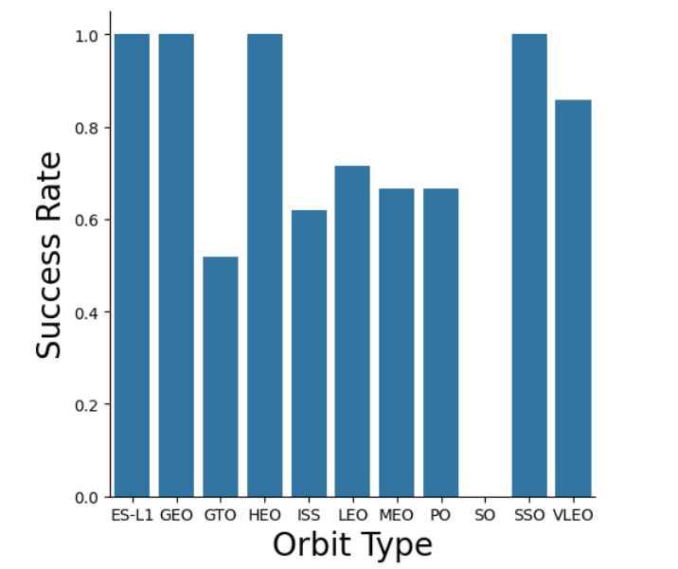
Success Rate vs. Orbit Type
Orbits with 100% success rate:
ES-L1, GEO, HEO, SSO
Orbits with 0% success rate:
SO
Orbits with success rate between 50% and 85%:
GTO, ISS, LEO, MEO, PO

Slide 21
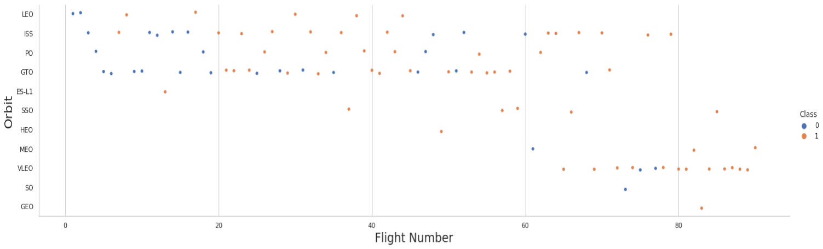
Flight Number vs. Orbit Type
We can see that in the LEO orbit the Success appears related to the number of flights; on the other hand, there seems to be no relationship between flight number when in GTO orbit.

Slide 22
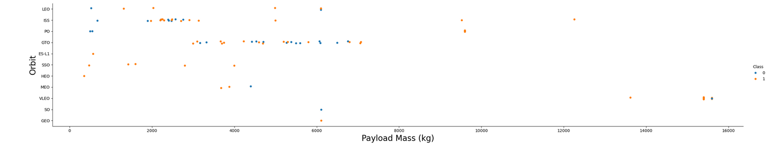
Payload vs. Orbit Type
Heavy payloads have a negative influence on GTO orbits and positive on GTO and Polar LEO (ISS) orbits.

Slide 23
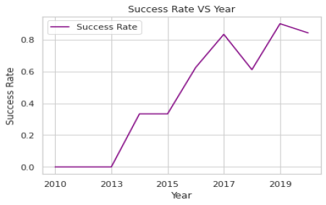
Launch Success Yearly Trend
We can observe that the success rate since 2013 kept increasing till 2020

Slide 24
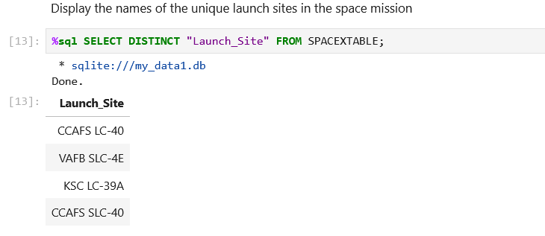
All Launch Site Names
As shown above we have 4 distinct sites for rockets launches listed in the Table above.

Slide 25
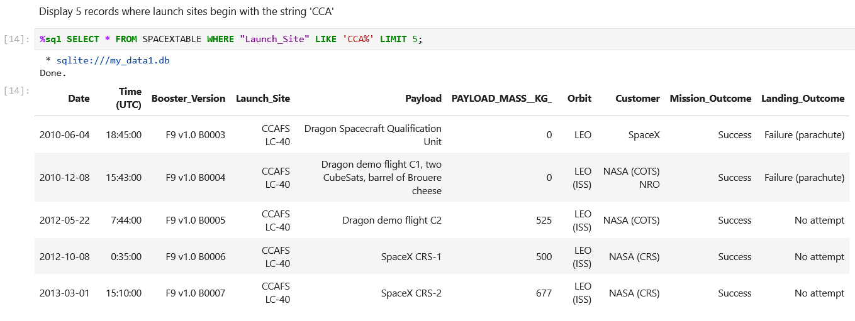
Launch Site Names Begin with 'CCA'
Displaying 5 records where launch sites begin with the string 'CCA'.

Slide 26
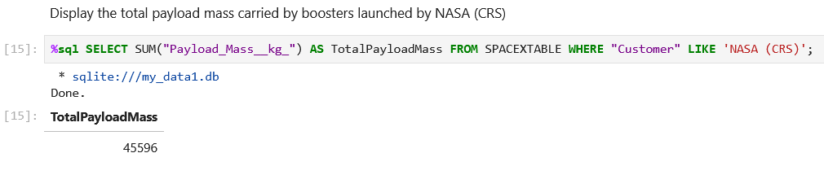
Total Payload Mass
The total amount of payload that moved to the outer space by NASA through SpaceX rockets equals to 45596 Kg

Slide 27
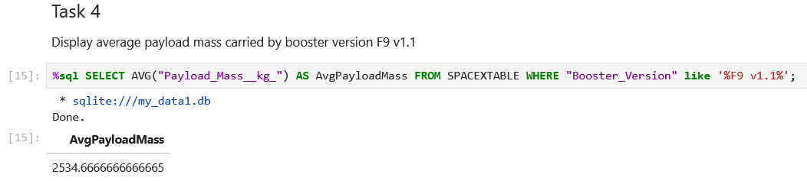
Average Payload Mass by F9 v1.1
The average payload mass carried by booster version F9 v1.1 is 2534 kg

Slide 28
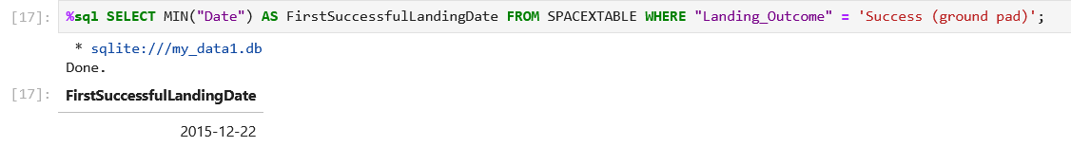
First Successful Ground Landing Date
Date of the first successful landing outcome on ground pad was in 22-12-2015

Slide 29
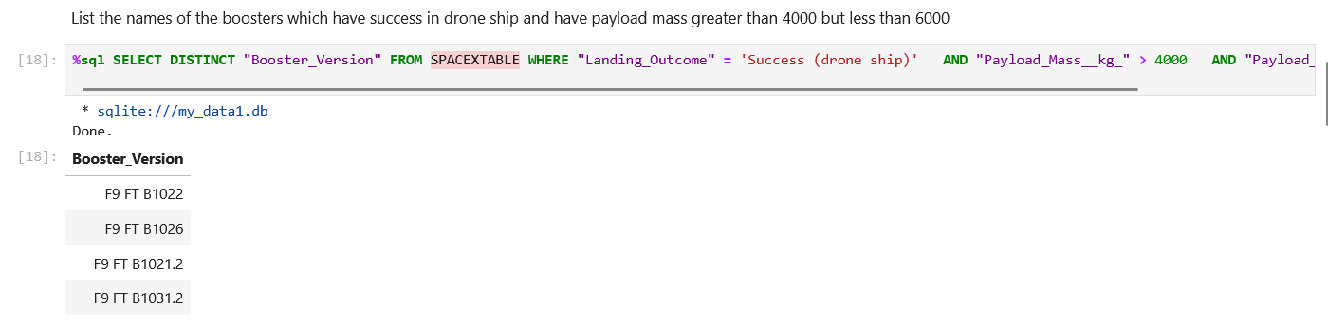
Successful Drone Ship Landing with Payload between 4000 and 6000
The boosters which have success in drone ship landing with payload between 4000 and 6000 kg are listed in above screenshot

Slide 30
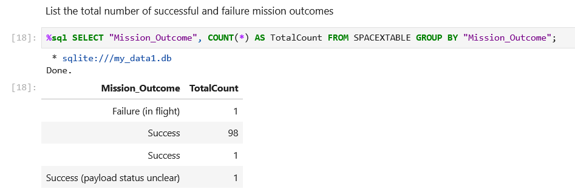
Total Number of Successful and Failure Mission Outcomes
We can see clearly that the success rate of mission outcomes is the most dominant we have only 1 failed mission while we have 99 successful ones.

Slide 31
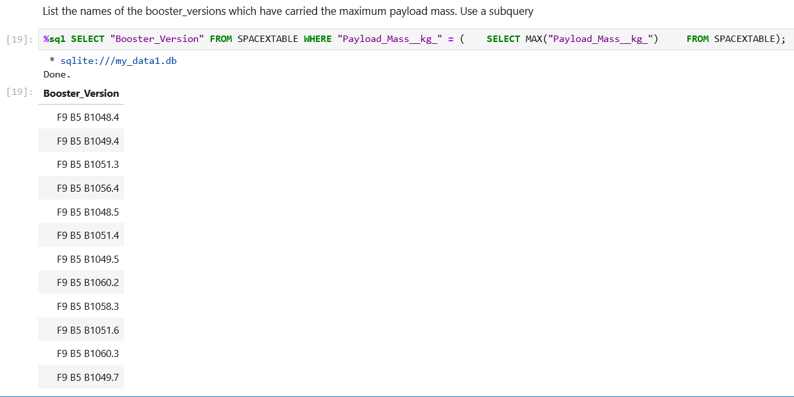
Boosters Carried Maximum Payload
The booster versions that carry the
maximum payload starts with F9 B5
and ranges from B1048 up to
B1060

Slide 32
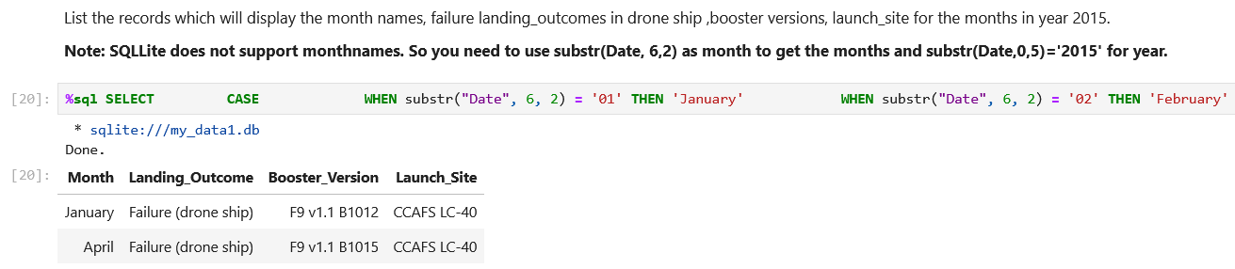
2015 Launch Records
We have two failed landing in 2015 on a drone ship which both in the same site, CCAFS LC-40 and with same booster version F9 v1.1

Slide 33
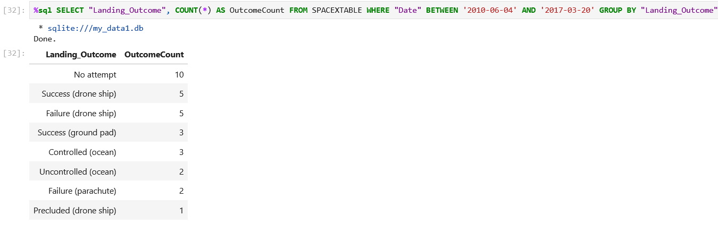
Rank Landing Outcomes Between 2010-06-04 and 2017-03-20

Slide 34

Section 3

Slide 35
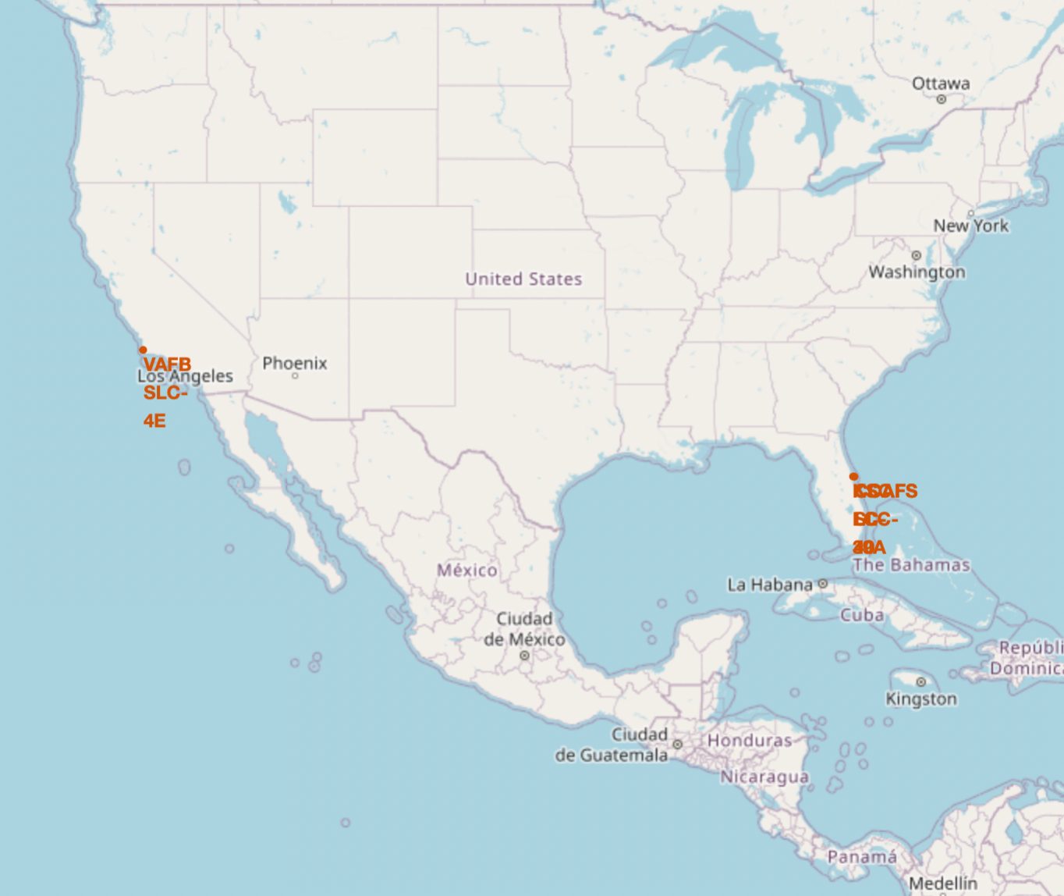
Folium Map: Launch Sites
Most launch sites are located near the Equator. The Earth's surface at the equator moves faster than at any other location, at a speed of 1670 km/hour. Consequently, when a spacecraft is launched from the equator, it not only ascends into space but also continues to move around the Earth at its initial velocity due to inertia. This speed assists the spacecraft in maintaining the necessary velocity to stay in orbit.
Additionally, all launch sites are positioned close to the coast. Launching rockets over the ocean minimizes the risk of debris falling or exploding near populated areas.

Slide 36
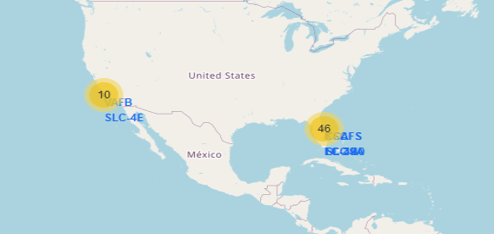
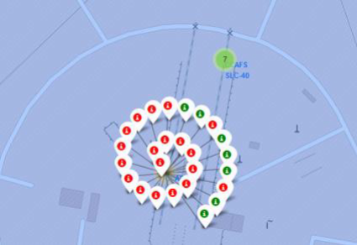
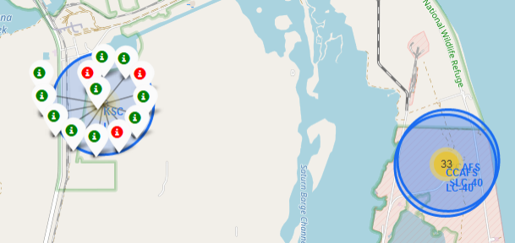
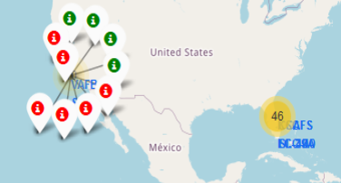
Folium Map: Success rate for each launch location
From the color-labeled markers in
marker clusters, we can easily identify
which launch sites have relatively high
success rates.
Green Marker = Successful Return
Red Marker = Failed Return

Slide 37
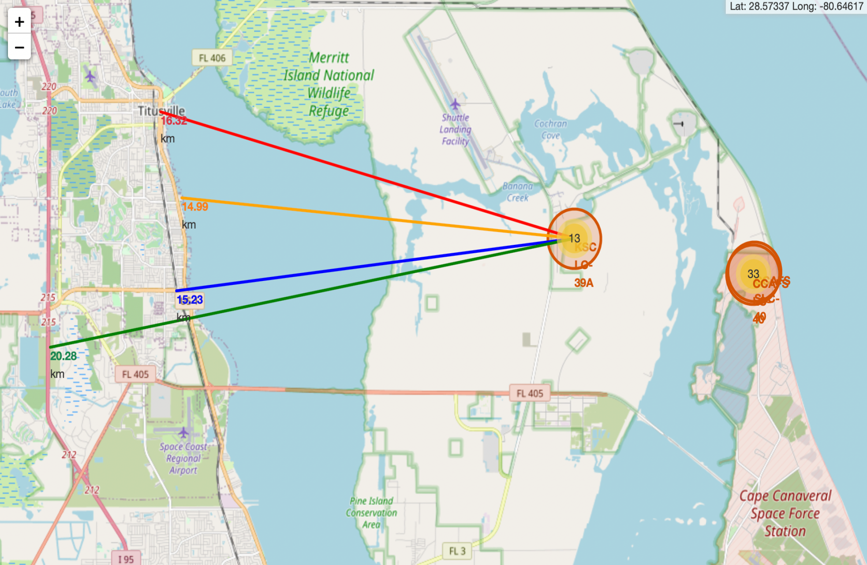
Folium Map: Safe Distance to Launch Site
From the visual analysis of the launch site KSC LC-39A we can clearly see that it is:
relative close to railway (15.23 km)
relative close to highway (20.28 km)
relative close to coastline (14.99 km)
Also the launch site KSC LC-39A is relative close to its closest city Titusville (16.32 km).
Failed rocket with its high speed can cover distances like 15-20 km in few seconds. It could be potentially dangerous to populated areas.

Slide 38

Section 4

Slide 39
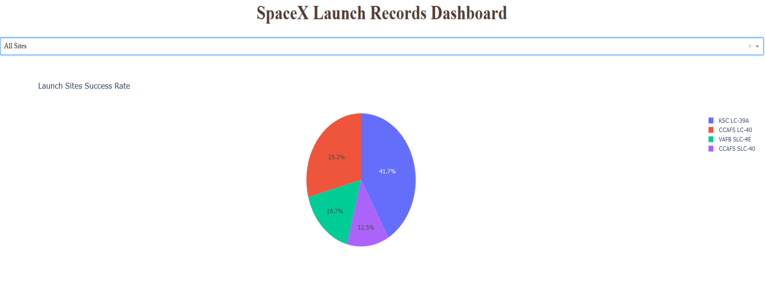
Dashboard: Launch success count for all sites
The graph shows the success percentage for every single site in terms of first stage return:
• The best site is KSC LC-39A with 41.7%. of total successful rocket launch among all sites
• The least site for successful rocket launch: CCAFS SLC-40 with only12.5%.

Slide 40
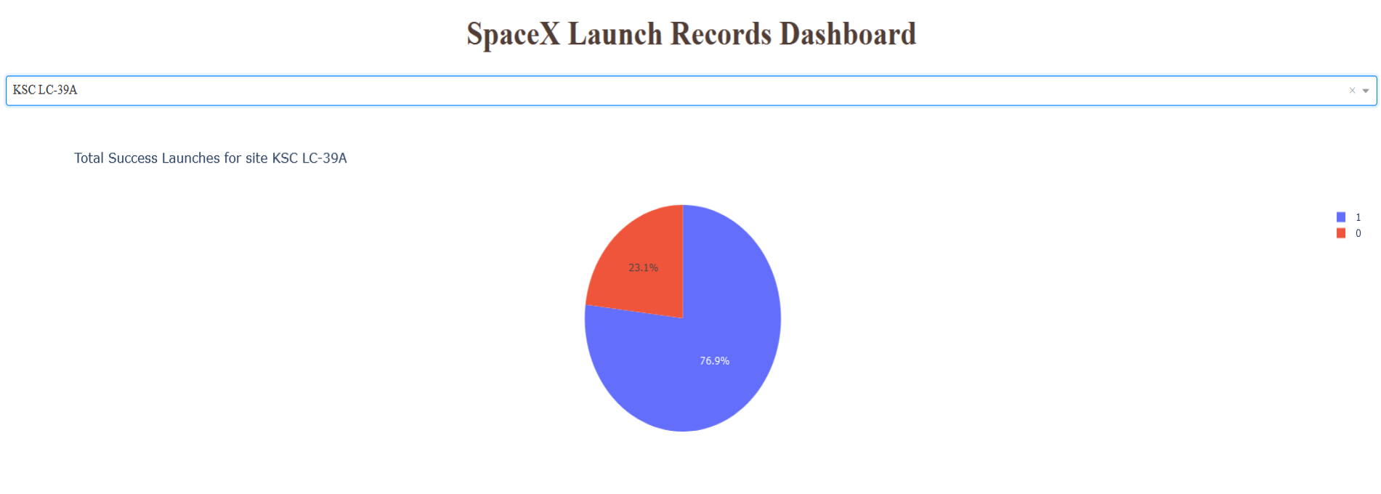
Dashboard: Launch success for KSC LC 39A
Total Success Launches for site KSC LC-39
• KSC LC-39A with 76.9% successful missions
• KSC LC-39A with 23.1% Failed missions

Slide 41
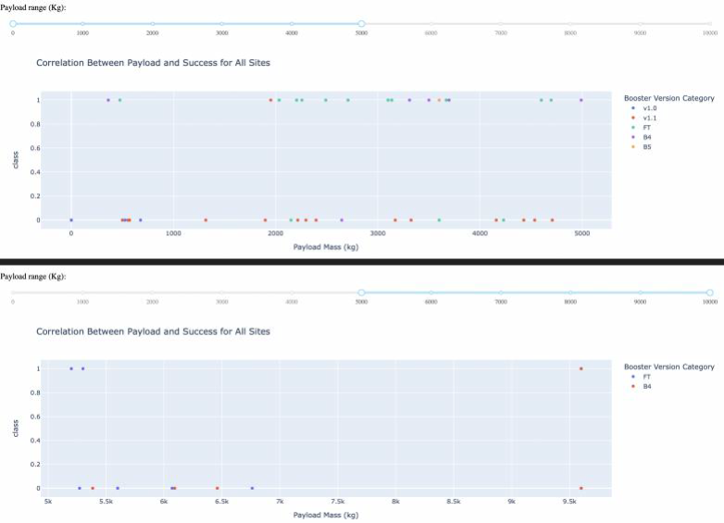
Dashboard: Payload vs. Launch Outcome for All Sites
The charts show that payloads
between 2000 and 5500 kg have
the highest success rate.

Slide 42

Section 5

Slide 43
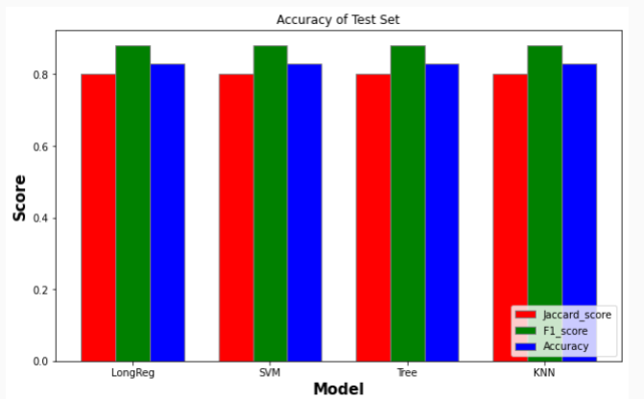
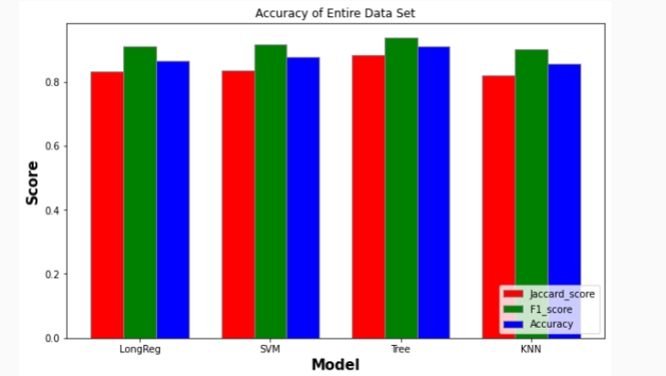
Classification Accuracy
• Using the test set the same accuracy results were obtained from the four models.
• The Tree Model provided the best accuracy results for the entire data set.

Slide 44
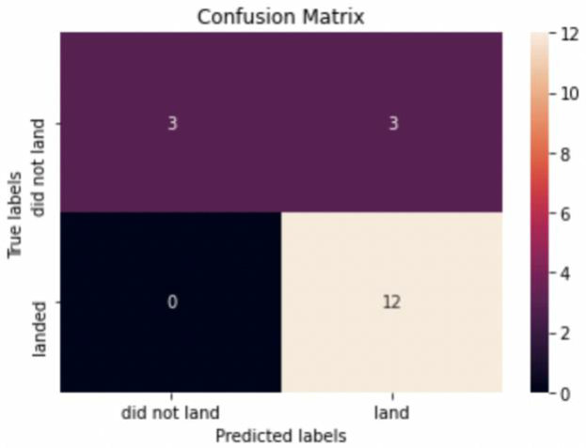
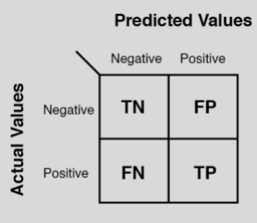
Confusion Matrix
• The confusion matrix analysis suggests that the best performing model is the Logistic Regression model.
• The confusion matrix predicts 13 true
positives, 3 false positives, 3 true positive,
and 0 false negative.

Slide 45
Conclusions
• Decision Tree Model is the best algorithm for this dataset.
• Launches with a low payload mass show better results than launches with a larger payload mass.
• Most of launch sites are in proximity to the Equator line and all the sites are in very close proximity to the coast.
• The success rate of launches increases over the years.
• KSC LC-39A has the highest success rate of the launches from all the sites.
• Orbits ES-L1, GEO, HEO and SSO have 100% success rate.

Slide 46
Appendix
Github Main URL: https://github.com/sajivallachira/Capstone/tree/main

Slide 47


